Slide 1
Chapter 5
Interrupts and Power Management

Slide 2
Table of Contents
Introduction
Microcontroller Architecture
Software Development Platforms
Digital Input and Output
Interrupts and Power Management
Timing Operations
Conversion Between Analog and Digital Values
Digital Communication
Memory Operations
Real-time Operating Systems
LCD, Touch Screen, and Graphical User Interface Formation
Introduction to Digital Signal Processing
Introduction to Digital Control
Introduction to Digital Image Processing
Advanced Topics

Slide 3
LAYOUT
The Interrupt Concept in Embedded Systems
  Interrupts in General
  Interrupts in the STM32F4 Microcontroller
Interrupt Setup in the STM32F4 Microcontroller
Interrupt Usage in the STM32F4 Microcontroller
Power Management in Embedded Systems
  Importance of Power Management in Embedded Applications
  The Link Between Power Management and Interrupt Usage
  Battery as Power Supply
Power Management in the STM32F4 Microcontroller
  Power Management Features
  Power Supply Options
  Power Modes
  STM32CubeMX for Power Usage Analysis
Usage of Power Modes in Code

Slide 4
Introduction
An embedded system either responds to an asynchronous request or performs an operation in a periodic manner most of the times.
One approach to handle such requests is letting the CPU wait in an infinite loop in idle mode till an asynchronous request comes or event period has been reached.
A better approach for such operations is the interrupt usage.
This method handles the problem such that the CPU performs its usual (or synchronous) operation and handles asynchronous or periodic operations when requested.
The recent trend in embedded systems is consuming as less power as possible.
Hence, the system deployed to a remote location can run on battery or by its own energy harvesting module.
Power management and interrupt concepts are related.

Slide 5
The Interrupt Concept in Embedded Systems
An embedded system should be interacting with the outside world by its nature. Moreover, it should respond to a request coming from the user.
One option to handle such requests is forming an infinite loop in the code and checking requests in a continuous manner. Although this method is useful in its own rights, it blocks the CPU.
To overcome this problem and freeing up the CPU from waiting in an infinite loop, a different programming approach is needed.
The interrupt concept comes into play for this purpose.
Within this approach, asynchronous or periodic requests can be handled without letting the CPU to wait for them indefinitely.
One can think of interrupt as a response mechanism to an input signal such that when it occurs, a predefined function is executed by the CPU.
The difference of the interrupt is that when the required input is not fed to the microcontroller, the CPU performs its usual synchronous operation. Hence, it does not wait for an event to occur in the infinite loop.

Slide 6
The Interrupt Concept in Embedded Systems
Summary of the overall interrupt operation on an actual example. Setup phase:
The microcontroller controls a DC motor by sending a signal to it periodically.
The user can press a button to start or stop the motor. Another button can be used to change rotation direction of the motor. These button presses can happen any time. Hence, the CPU should handle these asynchronous inputs besides feeding the signal to the motor.
The interrupts are generated when two separate buttons connected to the microcontroller pins are pressed. Hence, we have GPIO interrupts.
To handle these, we should setup the microcontroller such that related GPIO pins should be able to generate interrupt requests.
The user should also set priority to each interrupt request. In other words, the user should rank the interrupt requests coming from the start-stop and rotation direction buttons.
As these settings are done, the pins will be ready to form interrupt requests. Besides, the CPU should be set to accept and handle these requests.

Slide 7
The Interrupt Concept in Embedded Systems
Summary of the overall interrupt operation on an actual example. Interrupt comes:
When a button (either controlling the start-stop or rotation direction) connected to the pin is pressed, the voltage difference there is sensed by an edge detector circuit connected to the pin of the microcontroller.
As a result, a flag is set indicating that the pin generated an interrupt request.
A special module handles this interrupt request. To do so, it first checks whether the request is allowed or not.
Then, the module checks priority of the incoming interrupt such that it should precede the existing operation.

Slide 8
The Interrupt Concept in Embedded Systems
Summary of the overall interrupt operation on an actual example. Responding to the interrupt request:
The CPU is diverted to the function to be executed as a response to the interrupt request.
This function is called interrupt service routine (ISR) or callback function.
For our example, the motor start-stop and rotation direction change operations should be done within their specific callback functions.
These functions are defined within the code. However, they are not called by their name in the code.
Instead, the hardware signal generated by the associated button press calls each function.
As the CPU starts executing the callback function, the related flag should be reset.
Hence, the CPU knows that the interrupt is handled and there is no need to pay attention to it again.
As the operation within the callback function is done, the CPU turns back to its previous operation.

Slide 9
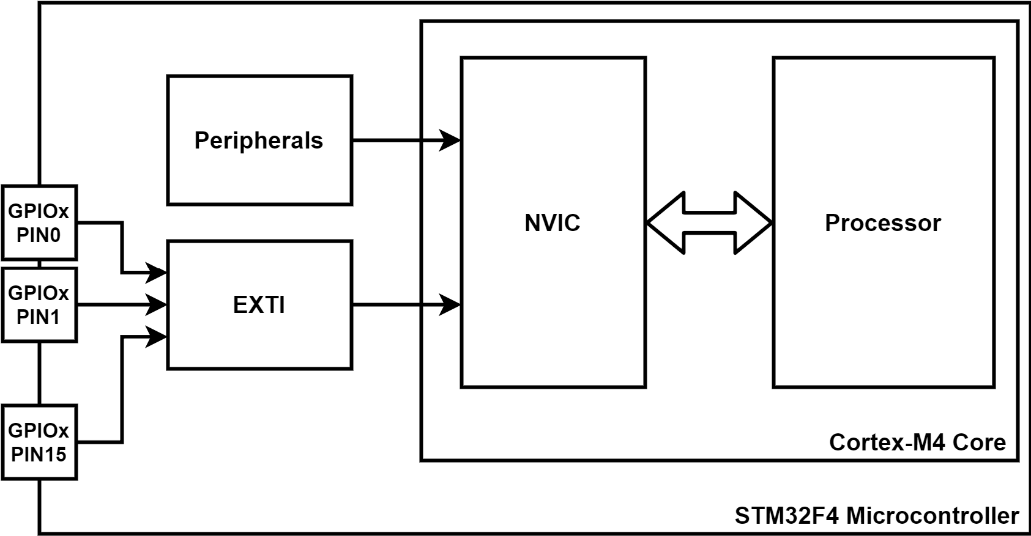
Interrupts in the STM32F4 Microcontroller
Block diagram of the STM32F4 interrupt based modules

Slide 10
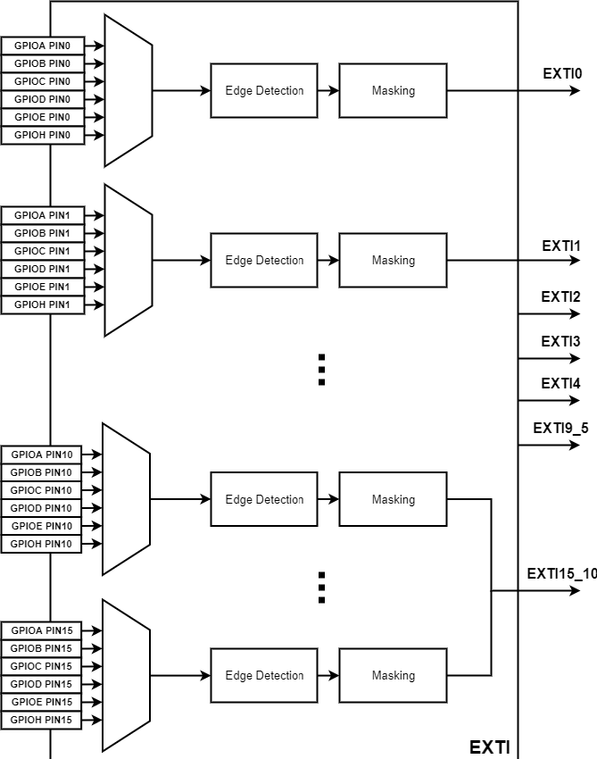
Interrupts in the STM32F4 Microcontroller
Detailed block diagram of the EXTI module.

Slide 11
Power Management in Embedded Systems
Importance of Power Management in Embedded Applications
Embedded systems can be used in stand-alone applications in which they may depend on battery.
In order to extend working time of the overall system, we have three options.
  select a battery with larger capacity.
  design a system with battery recharging capability.
  decrease power consumption of the embedded system.
Due to importance of the problem, recent microcontrollers provide power management options to the user.
Arm® Cortex™-M architecture is well-known in this respect.
Power management in microcontrollers starts by decreasing the power consumption of the device.

Slide 12
Power Management in Embedded Systems
The Link Between Power Management and Interrupt Usage
The microcontroller performs its operations in active (run)mode. This mode has the highest power consumption.
One of the most important usage area of interrupts is letting the CPU in low power modes.
If the operation to be performed by the CPU is infrequent, one option is letting the CPU to run continuously in an infinite loop to wait for the event to be responded.
Since the event is rare, most of the power will be dissipated while waiting for the event to occur.
The next option is setting the system such that it stays in an appropriate low power or sleep mode.
When the external event occurs, it triggers an interrupt. Afterward, the CPU wakes up, performs the operation related to the event in active mode, and goes back to its previous low power mode again.
Hence, the system stays in active mode for a short period of time or when only needed. For the remaining times, the system stays in low power mode and does not dissipate power as it does in the active mode.

Slide 13
Power Management in Embedded Systems
Battery as Power Supply
The embedded system is powered by battery most of the times when used in a stand-alone application.
the rechargeable battery
  can be used more than once.
  the charging circuit increases the overall cost.
  rechargeable batteries are expensive.
  lifetime of a rechargeable battery is around 1000 to 2000 charging.
the disposable battery
  can be used without any charging circuitry.
  It is cheap.
  the disposable battery can only be used once and should be replaced when depleted.
Capacity of a battery is provided in milliampere hour (mAh) by the manufacturer.
This indicates the current value the battery can provide within one hour in predefined voltage level. The other explanation is as follows. Capacity indicates how many hours can the battery be used when the mentioned current is drawn from it.

Slide 14
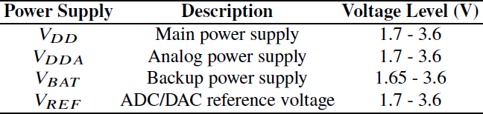
Power Management in the STM32F4 Microcontroller
The STM32F4 microcontroller power supply options

Slide 15
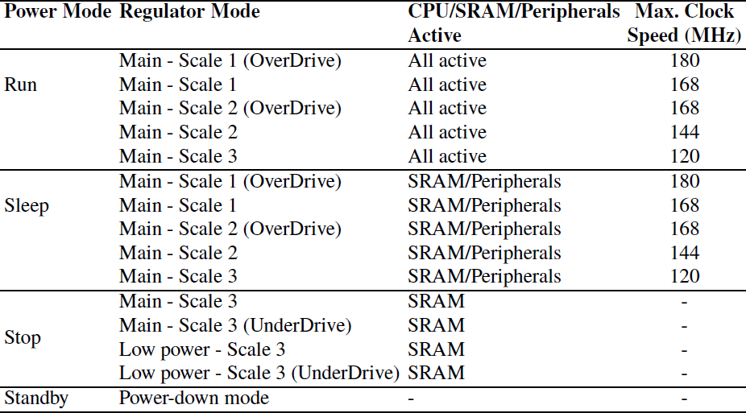
Power Management in the STM32F4 Microcontroller
The STM32F4 microcontroller power modes

